Slide 1
Step-by-step walk through the solution
MODEL BUILDING: Salient features of each model used
INSERT DETAILS for each model
Faster
R-CNN
Inception
Net v3
ResNet50
U-NET
We apply transfer learning of the Faster R-CNN model i.e. pre-trained model on the COCO dataset
We split the data into 90:10, trained the model
This code is developed using RoIAlign instead of RoIPooling
We used Visualizer utility to draw the predictions on the image
VGG19
xyz
xyz
xyz
xyz

Slide 2
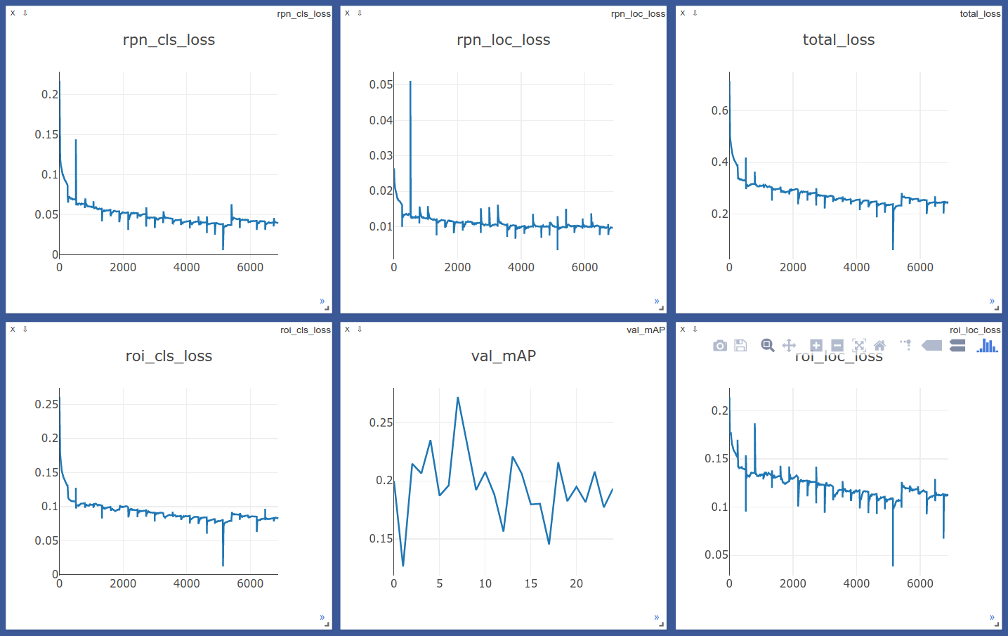
SAMPLE – can we make & display graphs like this?

Slide 3
Comparison to benchmark
How does your final solution compare to the benchmark you laid out at the outset? Did you improve on the benchmark? Why or why not?
We expected high mean average precision of ### at the outset but did not quite achieve the same. We measured it for various IoU thresholds
REVISIT

Slide 4
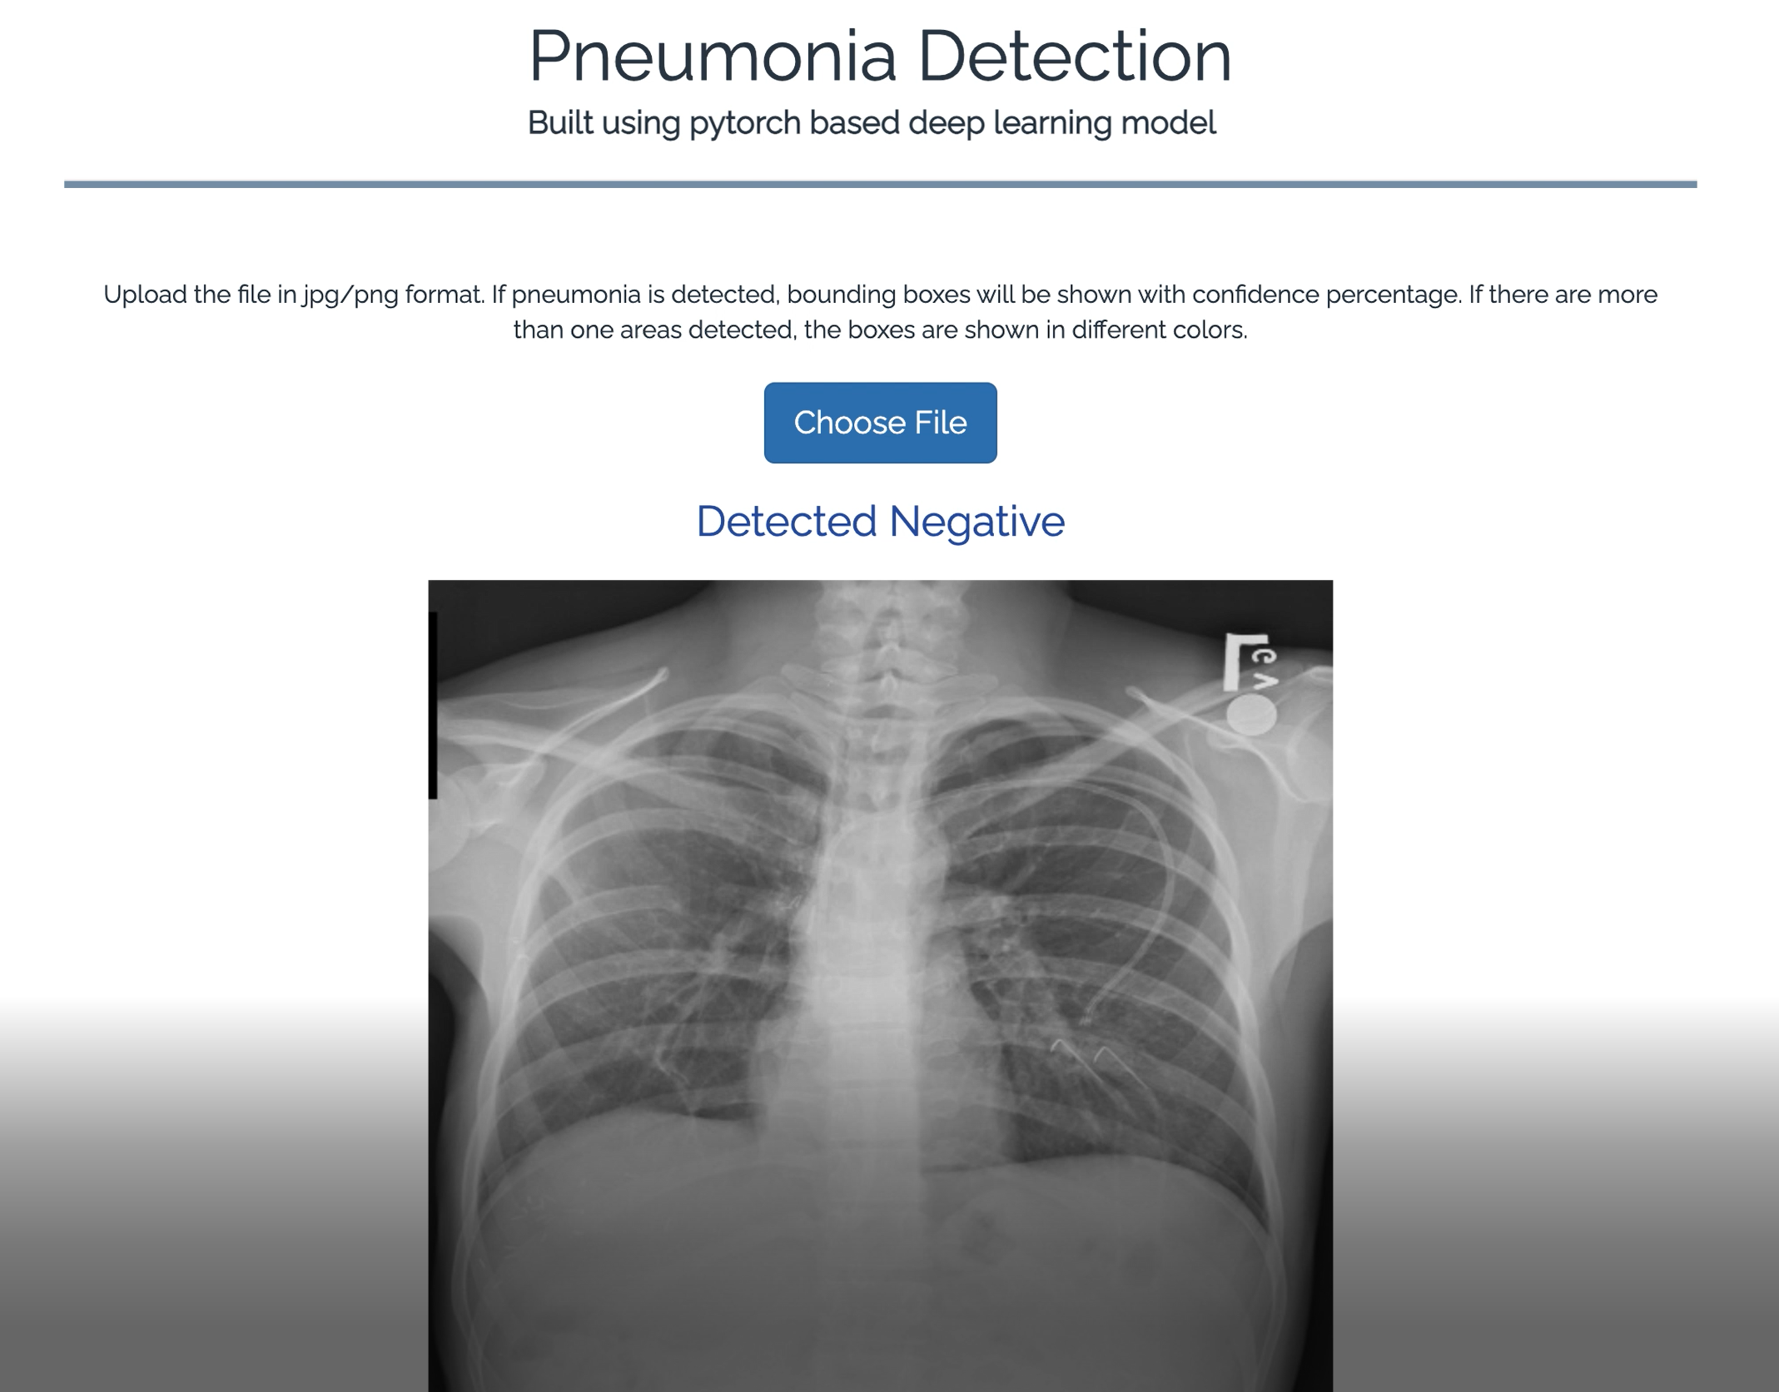
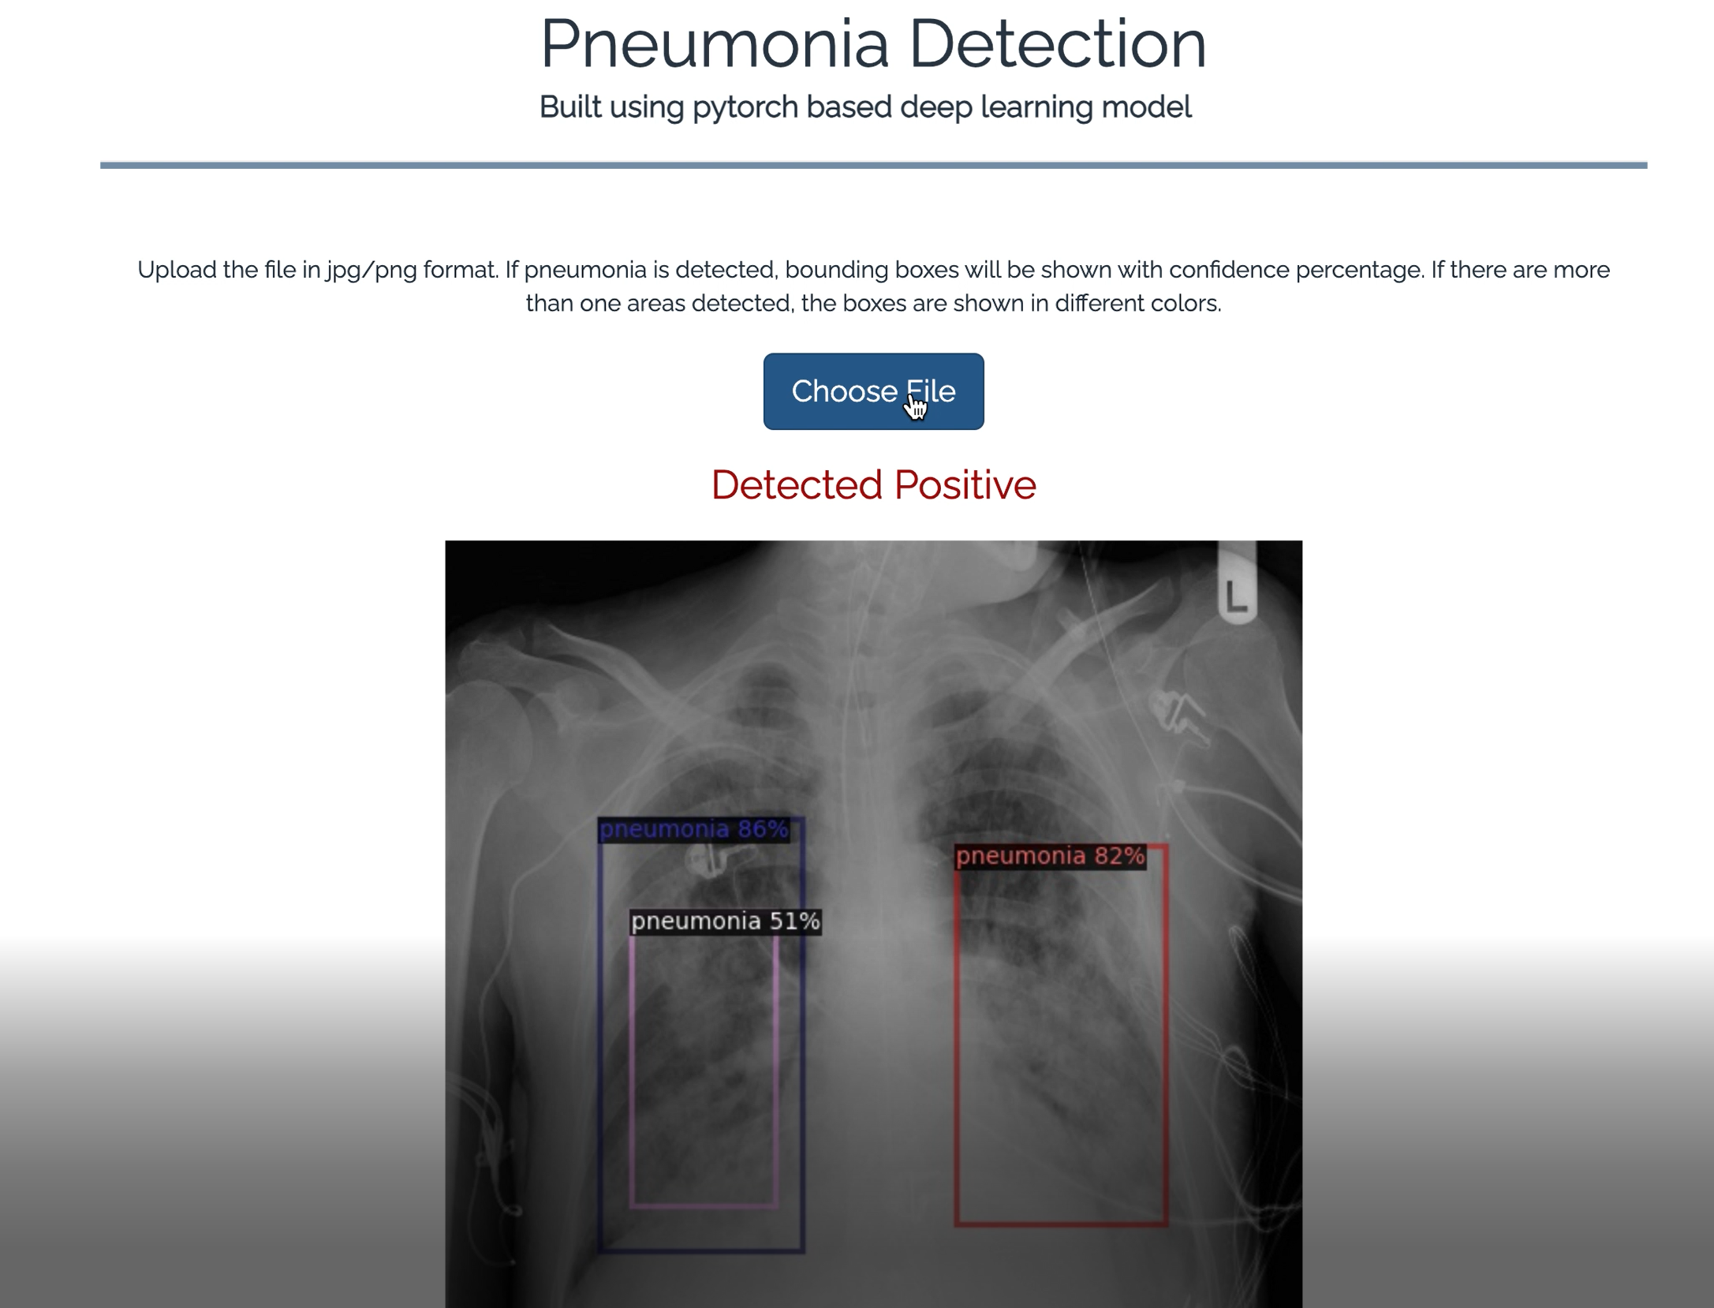
Model Deployment - xyz
INSERT DETAILS on deployment
USER INTERFACE

Slide 5

Implications
Review
How does your solution affect the problem in the domain or business? What recommendations would you make, and with what level of confidence?
The size, shape, and position of pneumonia can vary a great deal. Its target contour is very vague, which leads to great difficulty with detection, and enhancing the accuracy of detection is a major research problem. Medical testing has high requirements for accuracy, and hence two-stage detectors such as Faster R-CNN have an advantage in this respect.

Slide 6
TRUE POSITIVE
TRUE NEGATIVE
Insert cases of each
FALSE POSITIVE
FALSE NEGATIVE

Slide 7

Limitations
Review
There are still problems with the backbone network of the current detection algorithms. For example, ResNet generally has two problems: a large network depth leading to long training time and massive down-sampling that leads to the target position and semantic information being lost
The dataset contains three categories of subjects, normal, pneumonia, and abnormal(cancer or other diseases) but only provides the bounding box for pneumonia images. However, the features of pneumonia and abnormal(cancer or other diseases) are pretty similar, which caused the failure to distinguish pneumonia and abnormal images for Faster R-CNN. This results in predicting bounding box for abnormal images
Different distribution of train and test datasets, most likely due to different labeling methodology
What are the limitations of your solution? Where does your model fall short in the real world? What can you do to enhance the solution

Slide 8

Closing Reflections What have you learned from the process? What you do differently next time?
Learnings?
We had class imbalance for pneumonia cases in our dataset. Hence, using NIH dataset since It's a bigger dataset but with lower quality of labels, would be very interesting to check if training the model to predict both datasets would improve the result, or at least use it to pretrain the base model

